Slide 1

COGNITIVE STATE ESTIMATION FOR ONLINE MEETINGS USING MACHINE LEARNING
Nazera Khana
&
Merian Gabra
College of Engineering at Tennessee State University
Department of Computer Science
Course instructor
Dr. Ali Sekmen
Technical Advisor
Mr. Christopher Jones
COMP 4510
Notes:
Welcome everyone: My name is Nazera Khana, I am going to cop resenting this session on Cognitive State estimation for Online Meetings using Machine Learning with Merian Gabra We have worked with Mr. Chris Jones as Technical advisor and Dr. Ali Sekmen as course instructor. The purpose of this presentation is to discuss and talk about the important of Cognitive State estimation for Online Meetings using Machine Learning.

Slide 2
outline
Introduction
Goal and Objectives
Requirements
Functional requirements
Non-Functional Requirements
Design
System Architecture
Detailed Design
Implementation
Results
Completed Work
Future Work
References
Notes:
We will be introducing the project and discussing the goals and objectives and the Design and Implementation , results and finally we will be discussing all completed and future work.

Slide 3
Introduction
Impacts of covid-19 education
Remote learning with virtual meetings
Teaching has taken new methods
Instructors lose their connection with students
It is difficult to ensure everyone’s engagement through a screen
Notes:
Many, if not all of our lives have been impacted by COVID-19. Our education has shifted to online learning and our classes to be held virtually via webcam. Many of the teaching techniques we may already know have changed to less familiar ways. The instructors also cannot monitor all the students, together at the same time. Furthermore, it is difficult to detect emotion through a monitor. With our AI system, we can detect emotion facially expressed which is essential to assessing students learning.

Slide 4
Goal and Objectives
Our goal is focusing on virtual classrooms
Affective-cognitive recognition
Detecting Students’ emotions
Increase of instructor awareness

Slide 5
Functional Requirements
Implemented using MNIST handwritten digits dataset
50,000 images for training, 10,000 for Testing
different number of convolutional layers
CV development
File explorer by GUI
RGB to grayscale
Identify and compare existing facial expressions datasets
Training existing model for emotion recognition.
6,000 images for training and validation
Use 1,200 images for testing.
Notes:
graphical user interface
Rgb for color models red green and blue

Slide 6
Non-Functional Requirements
The Protection of the collected data
Windows and Mac OS accessibility
System with graphs production
Allowing the users to analyze the data of their performance in classes
Specific conditions are required while using the system
Privacy is a part of our program
Not Allowed for user to store others information without their permission
Notes:
The non-functional requirements
defines system attributes.

Slide 7

System Architecture

Slide 8
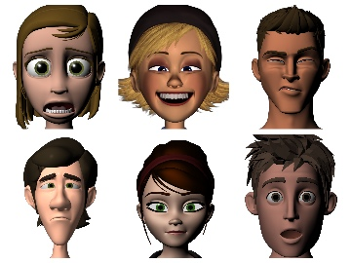
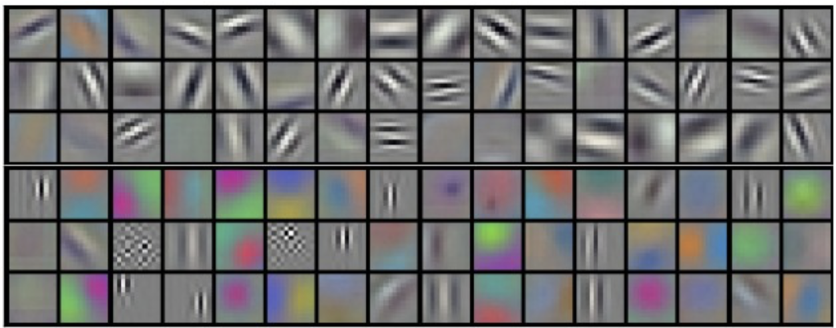
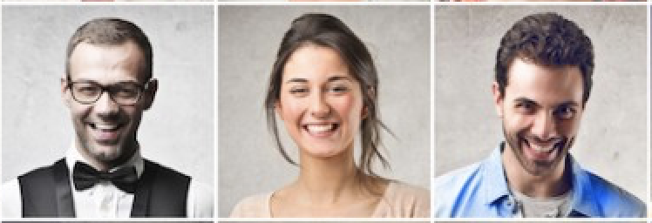
Database
DCNN Model Generation
CNN
Train
1
Filters
Test
3
Features
DCNN Model
Filter Parameters
Weights,
Biases
FCNN
Weights
Biases
4
2
Notes:
We start with a database of stored images. 80% of these images get processed through a DCNN(deep convolutional neural network). A 3 step process occurs within the DCNN. In the initial phase, images get fed through a Convolutional Neural Network of filters to extract specific features from them. Once that data has been extracted, it gets put through a FCNN(Fully connected neural network) to determine the weights and biases which will later help to identify the different emotions expressed. The more an image gets trained, the better the weights and biases get in the FCNN. The next step is to create a DCNN model that consists of filter parameters, weights and biases For every image, if a correct answer is given that means we do have a good model. A wrong answer means we have a bad Neural Network and the parameters need to be adjusted

Slide 9
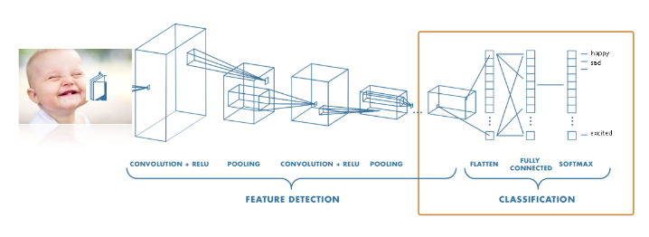
Detailed Design
Generating the dataset
Format
Input Image
Convolutional Neural Network
Convolution Layer
Filter layer
RELU
Pooling
Fully Connected CNN
Utilization of FCNN
End usage advantages of FCNN
Notes:
1. Our dataset are grayscale images
2. It consists of 28*28 = 784
3. We will have better resolution
Convolutional Neural Network
1. We will have inputs of 784 pixels of each image, and we will have hidden layers and output
2. Weights are supposed to control the signal between neurons
3. Given biases has a role as a constant value in the linear functions
4. We will use gradient descent algorithm to calculate the weights with inputs to the outputs
5. It will generate features vectors and it is faster than using other feature extraction tools such as swift
6. In hidden layers we Relu that is better than Sigmoid is a non-negative function, tanh is negative when X is less than zero
7. The primary function of this layer is to reduce the number of the parameters when images are large than required.
############
Fully Connected Neural network
1. every mode is fully connected to each other
2. we have the input that are features vectors hidden layers and the output that is the emotion of the that image
3. the outputs are including all probabilities for the emotions but only should the highest for example 020 0.01 0.95 and the sum is 1
Deep convolutional neural network
Consists from of both and operating as a one model
TensorFlow is a free and open-source software library for machine learning.TensorFlow is a Python-friendly open source library for numerical computation that makes machine learning faster and easierTensorFlow is an open source framework developed by Google researchers to run machine learningDropout:Dilution (also called Dropout) is a regularization technique for reducing overfitting in artificial neural networks by preventing complex co-adaptations on training data. It is an efficient way of performing model averaging with neural networks. The term dilution refers to the thinning of the weightsThe softmax function is a function that turns a vector of K real values into a vector of K real values that sum to 1. The input values can be positive, negative, zero, or greater than one, but the softmax transforms them into values between 0 and 1, so that they can be interpreted as probabilities.Max pooling is a pooling operation that selects the maximum element from the region of the feature ..Thus, the output after max-pooling layer would be a feature map containing the most ... Most popular in Machine Learning.Weights and biases (commonly referred to as w and b) are the learnable parameters of a machine learning model. ... When the inputs are transmitted between neurons, the weights are applied to the inputs along with the bias. A neuron. Weights control the signal (or the strength of the connection) between two neuronsGradient descent is a first-order iterative optimization algorithm for finding a local minimum of a differentiable function. To find a local minimum of a function using gradient descent, we take steps proportional to the negative of the gradient of the function at the current point

Slide 10
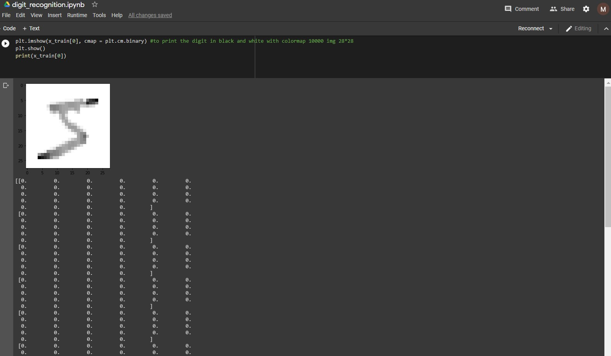
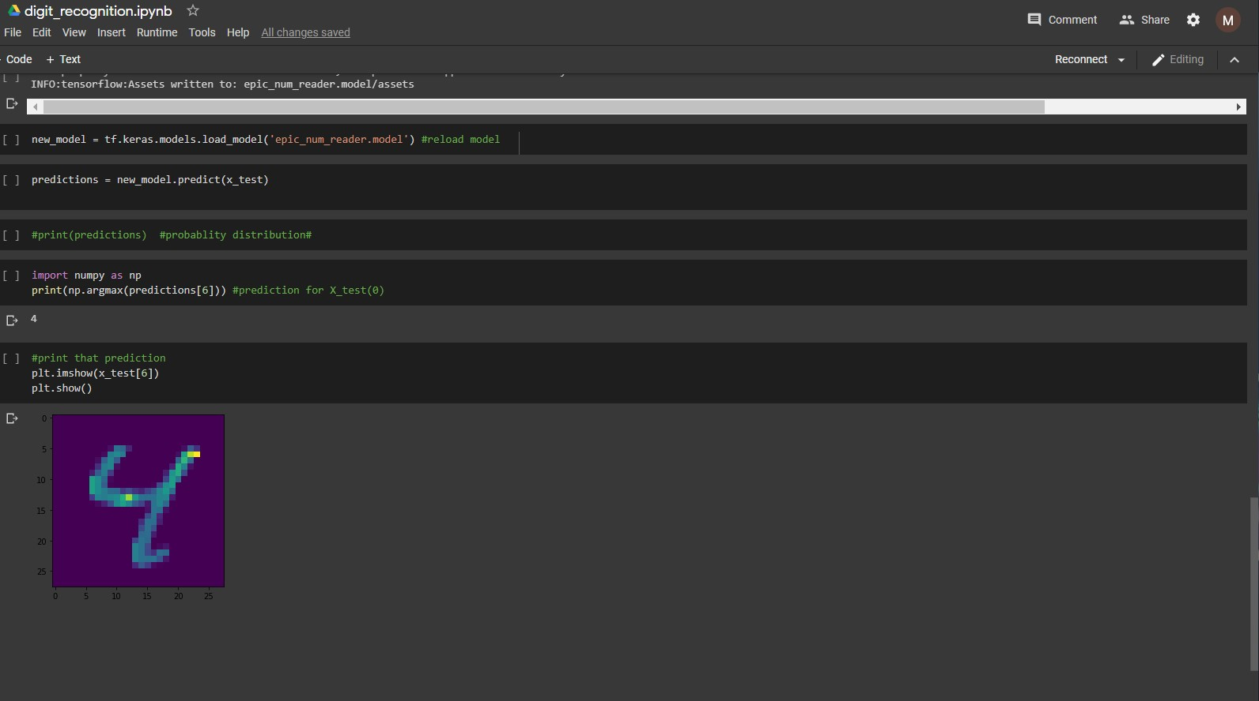
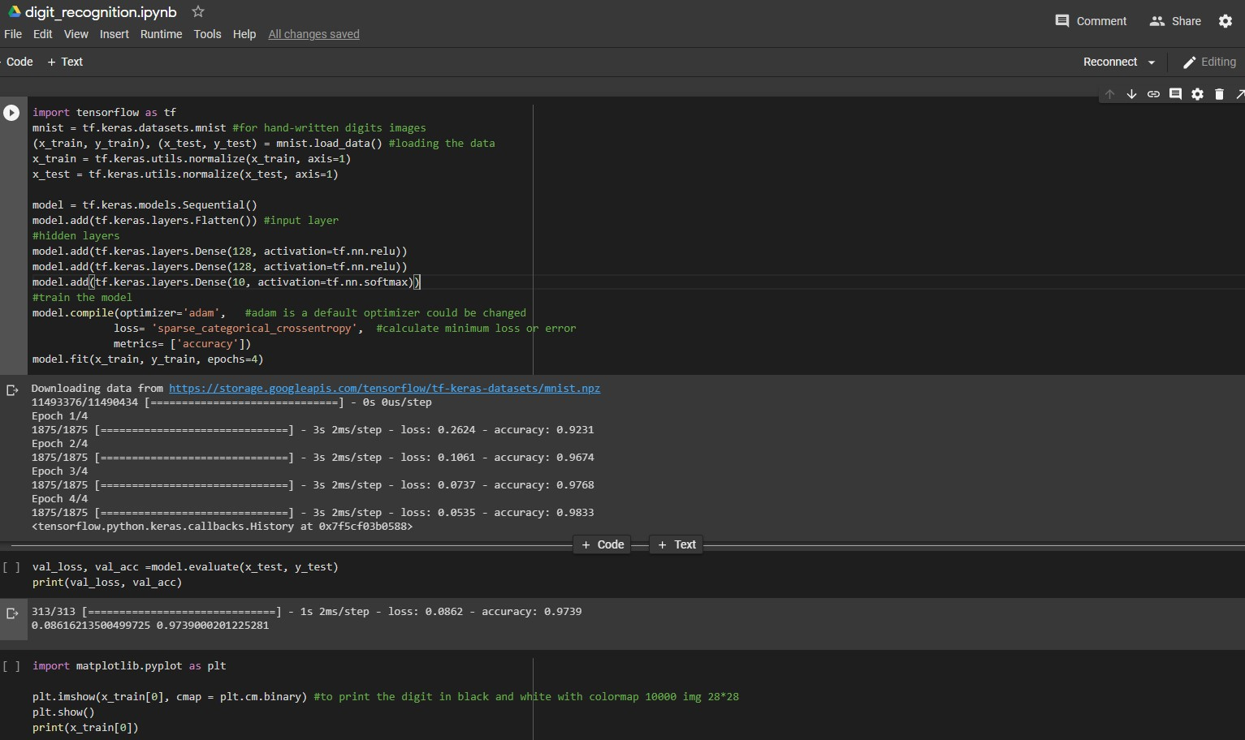
Preliminary Implementations
Notes:
We got many struggles for downloading TensorFlow so we will use google colab because it has it already
The dataset that is used in this tutorial from mnist
The image resolution is 28*28 from handwritten digits 0-9
Unpack the data
Then we scale or normalize our data to have values between 0 and 1
We build our sequential model
Then since it is multi-dimensional layer we will to flatten it with this model that built in Keras
For hidden layers there are dense and Relu
128 for the number of neurons that are used
Softmax in the output for probability distribution
Adam is one of the optimizers but for emotional recognition will gradient descent
Binary for black and white colors
Prediction for the image in index 0 is
When we print it should be

Slide 11
Implementations

Slide 12
Implementations
Comparing different dataset.
Processing the dataset
Choosing and modifying simple architecture model
Working on the increasing the accuracy
Implementing the model weights in still images
Implementing the model weights in real-time videos

Slide 13
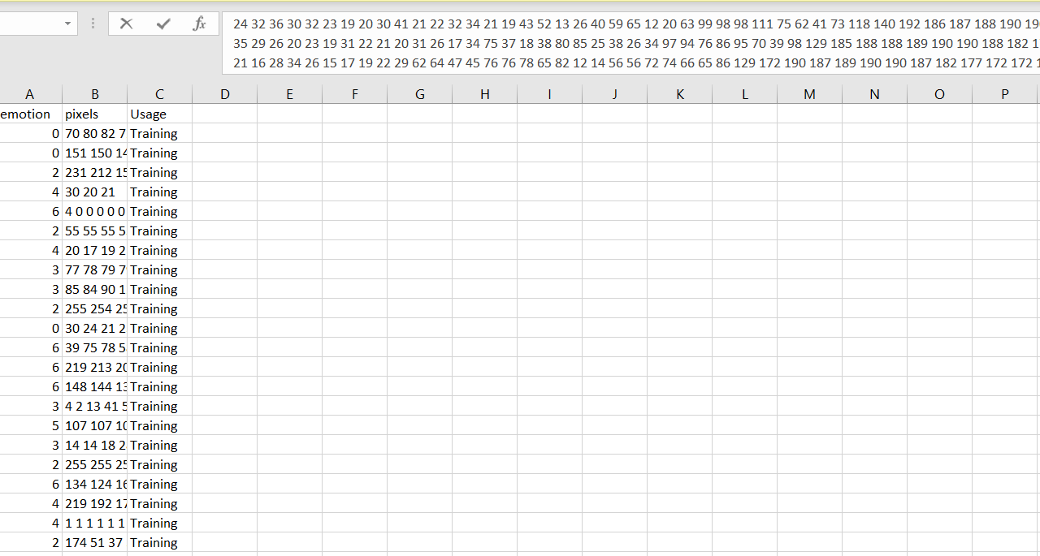
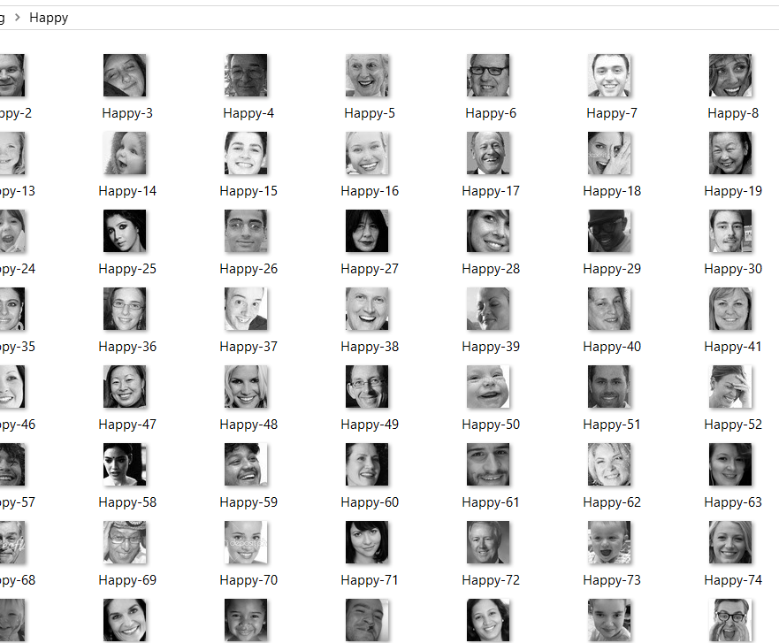


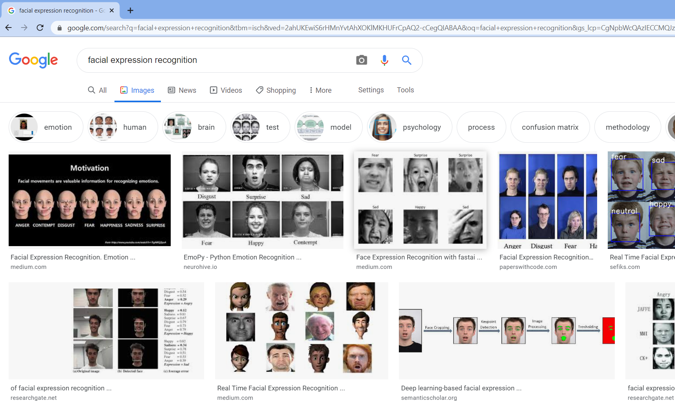

different dataset
Notes:
We followed steps how to code to download all dataset from google to pc directly.
In this project we have tried two different dataset from Kaggle.
One of them contains grayscale images for thousands of images.
The other dataset of facial expressions are stored in csv file (fer2013)
We have different dataset in here we started with google dataset and after we download it and used it we didn’t like it because it was to big and to cluttered means since it had more than one faces in each image and takes a lot to clean it up.We have been looking for another dataset and we found 2 different dataset from Kaggle one of them is folders labeled with Training and testing for the 6 emotions this dataset looks much better than the google dataset it was cleaner, and we had a single image for each face it was also easier to process but we found it was taking more than 5 hours to process all the dataset after that we looked for another dataset. we found another dataset csv file called fer2013 (facial expression recognition) It was provided to public resource so everyone can use it . We also decided it to use it because it was much faster and easier, and it was taking around one and half hour to use it rather than 5 hours

Slide 14
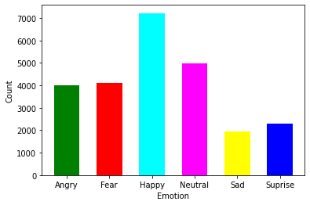
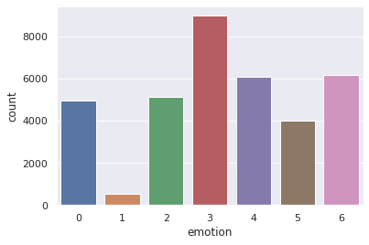
Processing the dataset
0-Angry
1-Disgust
2- Fear
3- Happy
4-Sad
5-Surprise
6-Neutral
Dataset folders
Dataset csv-file

Slide 15

Processing and labeling dataset of folders
The dataset are read from folders
The dataset are resized to 48x48 resolution
Reading grayscale images into NumPy array
Adding images to 80% training dataset, 80% training dataset labels, 20% of the dataset to validation dataset and 20% validation dataset labels

Slide 16
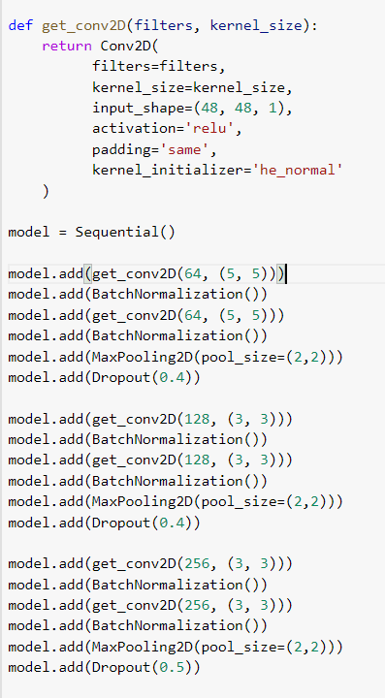
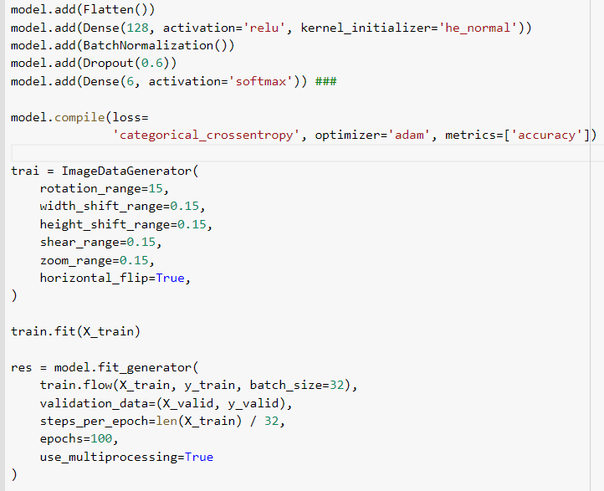
CNN Model
Notes:
A convolutional neural network that can robustly classify objects even if its placed in different orientations is said to have the property called invariance. More specifically, a CNN can be invariant to translation, viewpoint, size or illumination (Or a combination of the above)
Flipping: flipping the image vertically or horizontally.
Rotation: rotates the image by a specified degree.
Shearing: shifts one part of the image like a parallelogram.
Cropping: object appear in different positions in different proportions in the image.
Zoom in, Zoom out.
Data Augmentation in play. A convolutional neural network that can robustly classify objects even if its placed in different orientations is said to have the property called invariance. More specifically, a CNN can be invariant to translation, viewpoint, size or illumination (Or a combination of the above)
dropout can be used after convolutional layers (e.g. Conv2D) and after pooling layers (e.g. MaxPooling2D). Often, dropout is only used after the pooling layers, but this is just a rough heuristic. In this case, dropout is applied to each element or cell within the feature maps.
it applies same padding to the input image so that the input image gets fully covered by the filter and specified stride
He_normal this for initializing random number for weights and biases for the model
The Adam optimization algorithm is an extension to stochastic gradient descent that has recently seen broader adoption for deep learning applications in computer vision and natural language processing.
Batch normalization can be implemented during training by calculating the mean and standard deviation of each input variable to a layer per mini-batch and using these statistics to perform the standardization.
Batch normalization is a technique to standardize the inputs to a network, applied to ether the activations of a prior layer or inputs directly

Slide 17
results

Slide 18
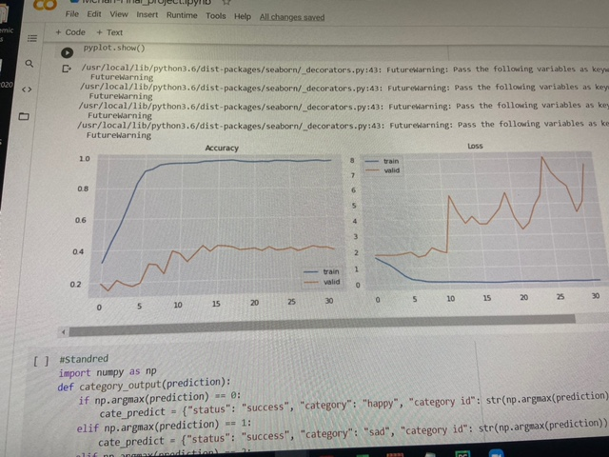
Overfitted model
Notes:
Specifically, the learning rate is a configurable hyperparameter used in the training of neural networks that has a small positive value, often in the range between 0.0 and 1.0. The learning rate controls how quickly the model is adapted to the problem

Slide 19
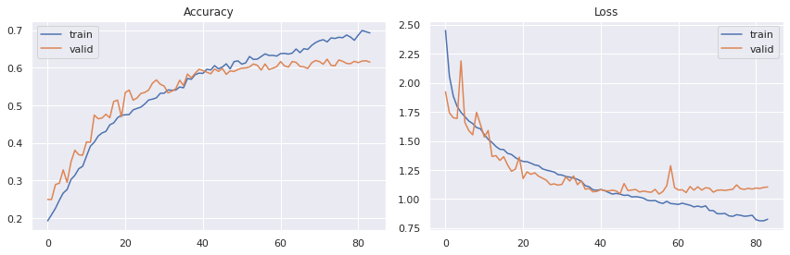
Accuracy for training 6000 images dataset

Slide 20
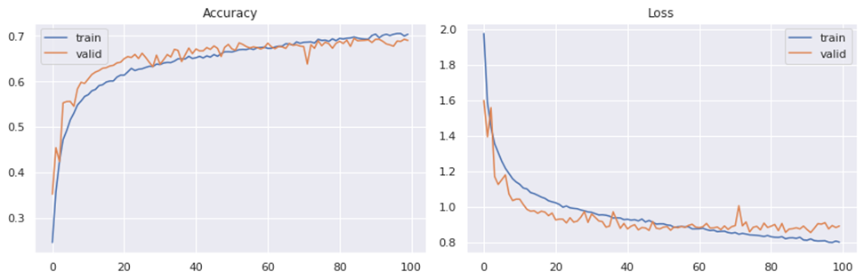
Without ImageDataGenerator

Slide 21
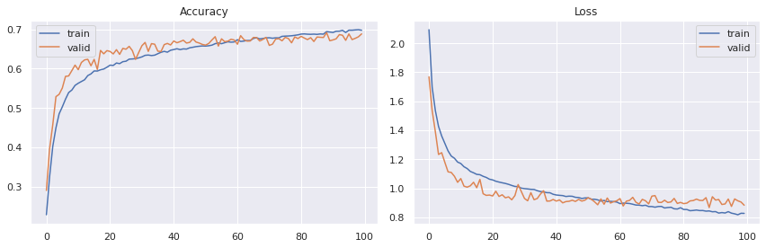
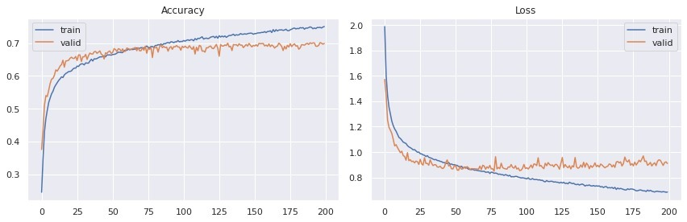
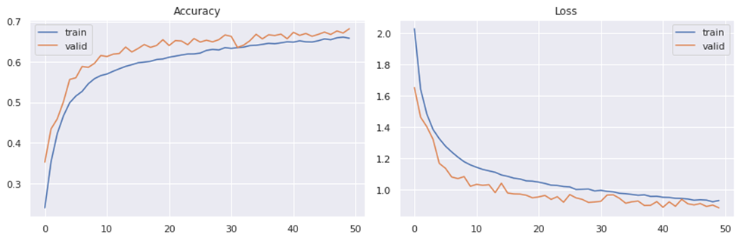

Slide 22
Results
Learning Rate | Validation Accuracy %
0.1 | 12.99
0.001 | 69.35
0.0001 | 67.12

Slide 23
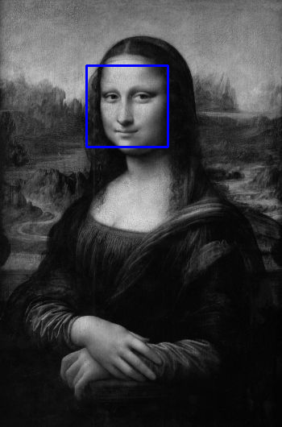
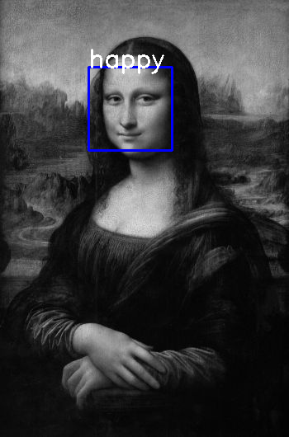
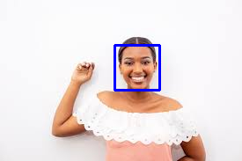
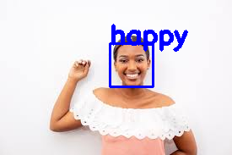
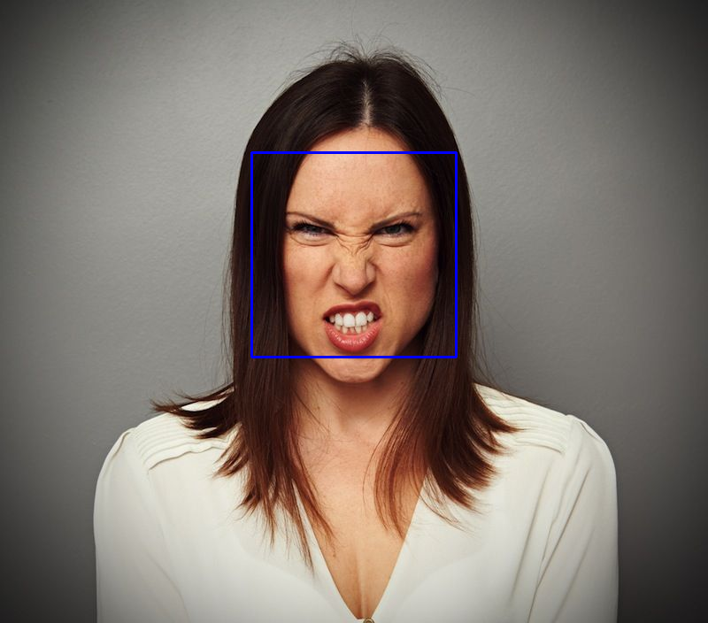
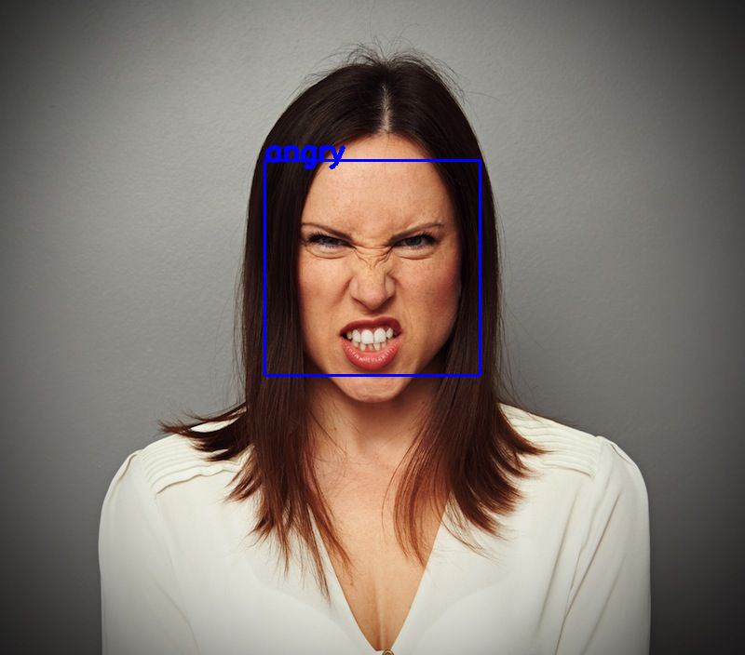
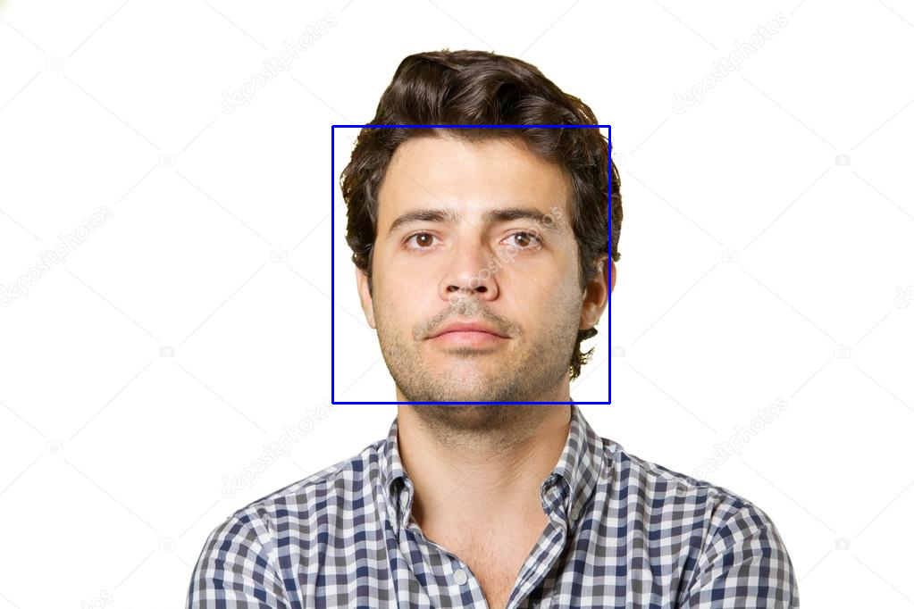
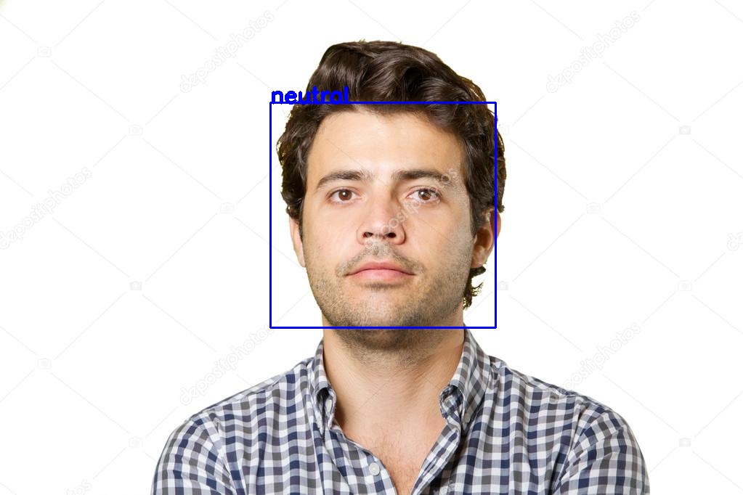
Testing the model with images

Slide 24
Webcam real-time video testing

Slide 25
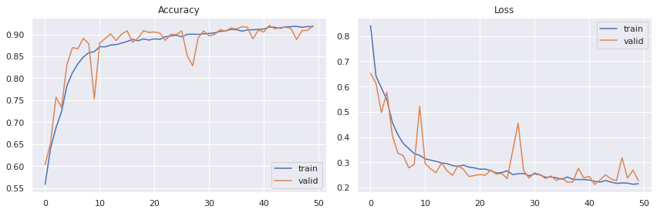
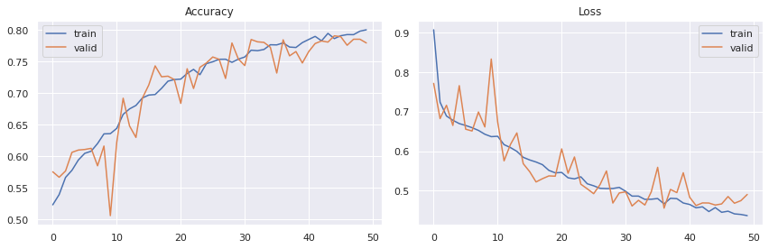
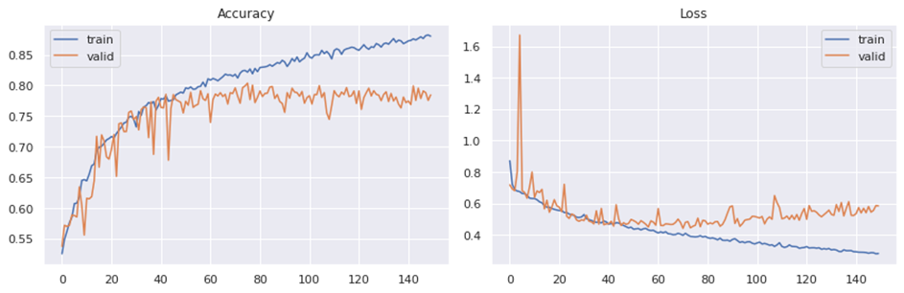
Happy-Neutral Model Results
Angry-Sad Model Results

Slide 26
Completed Work
Studying Deep learning
Related to computer vision and neural network
Google Colaboratory
Dataset for training and testing
Creating the architecture CNN model to get approximately 70% accuracy with complex dataset
Notes:
This was the first time for us to study in Deep learning before we started the project we had to studied first We also had to study in Google colab – we went through some tutorial to understand the COLAB and TenserFlow We also had to study Colab using GPU rather than CPU Because GPU was faster than CPU We also created a CNN model and we got the sample architecture model and we tried to modified it more and more To get this accuracy 70% with the batch size of 32 and epoch with 100 when we compared to so many research paper published online they got accuracy between , 60, 85 and 90 and they used different models other than CNN

Slide 27
Technical issues
From the very beginning when we were running codes on Anaconda Navigator, we could not get TensorFlow to be imported.
We moved to google Collaboratory
We were using CPU and it took too long with running the training model until we figured out, we can use GPU with training model.
We also ran into issues with our GPU(Graphics Processing Unit) access
We had to upgrade our account for google colab to have colab pro.

Slide 28
Future Work
Implementation
Increasing the model accuracy
Trying different architecture models
Zoom platform
Notes:
In the future, we plan to train our dataset with a different model to get more accuracy. And once we have better accuracy, along with more knowledge with the zoom platform, we will work to add our model weight to zoom to detect the faces in zoom meetings and recognizing emotions

Slide 29
References
https://www.researchgate.net/publication/338431245_A_real_time_face_emotion_classification_and_recognition_using_deep_learning_model
https://pythonprogramming.net/loading-custom-data-deep-learning-python-tensorflow-keras/
https://towardsdatascience.com/understanding-gradient-descent-and-adam-optimization-472ae8a78c10/
https://ieeexplore.ieee.org/abstract/document/8576656/

Slide 30

Thank you
Notes:
We would like to give a special thanks to Dr. Ali Sekmen and Mr. Christopher Jones for all their help along this journey. We would also like to thank the Department of Computer Science and angering college for providing us with the necessary resources to create a successful project.

Slide 31

questions

